Slide 1
DRAFT SCHEDULE
Activity | Start Date | Finish
Tech editing (HDR) | 15-Oct-15 | 20-Oct-15
PDT Consistency Review | 20-Oct-15 | 23-Oct-15
Sponsor Review | 26-Oct-15 | 30-Oct-15
QA/SQC | 26-Oct-15 | 30-Oct-15
DQC/SPK Policy Review | 26-Oct-15 | 30-Oct-15
Incorporate comments and finalize draft Watershed Report | 30-Oct-15 | 13-Nov-15
Circulate Package for SPK signatures (i.e. chop) | 16-Nov-15 | 20-Nov-15
Submit draft Watershed Report to SPD* |  | 20-Nov-15
CONCURRENT REVIEW (initiation thru completion) | 23-Nov-15 | 22-Jan-15
Concurrent Review (SPD, ATR) | 23-Nov-15 | 22-Jan-15
ATR Kick-off Meeting |  | 24-Nov-15
Comments submitted in Dr Checks by the ATRT | 24-Nov-15 | 11-Dec-15
Informal Public Meeting (Yuba County Government Center, Marysville, CA) |  | 2-Dec-2015
Evaluations in Dr Checks by PDT | 11-Dec-15 | 18-Dec-15
Revised Documents by PDT for backchecks by ATRT on Dr Checks and Elmo link | 18-Dec-15 | 8-Jan-16
Close-out SPD/ATR comments | 4-Jan-16 | 22-Jan-16
All ATR and SPD Comments Close-out | 11-Jan-16 | 15-Jan-16
Review Report complete and signed by ATR Lead, RMO POC and District POC | 18-Jan-16 | 22-Jan-16
FINALIZE WATERSHED REPORT | 25-Jan-15 | 12-Feb-16
Incorporate comments into Final Watershed Report | 20-Jan-15 | 5-Feb-16
Circulate Package for SPK signatures (i.e. chop) | 9-Feb-15 | 12-Feb-16
Submit Final Watershed Report for approval* |  | 12-Feb-16
REPORT APPROVAL | 16-Feb-16 | 16-Mar-16

Slide 2
Back-up Slides

Slide 3

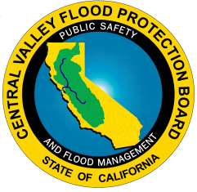
Central Valley Integrated Flood Management Watershed Study (CVIFMS) Informational Briefing
Rhiannon Kucharski – Lead Planner
Sacramento District, US Army Corps of Engineers
November 18, 2015

Slide 4
Outline
Recent Activities
Current Activities
Planning Goals
Array of Measures
Opportunity Areas
Qualitative Screening
Conceptual Alternatives
Early “Off-shoot” Study
Draft Proposed “Spin-off” and “Off-shoot” Studies
Schedule

Slide 5
What is CVIFMS?
Federal companion document to Central Valley Flood Protection Plan, Regional Flood Management Plans and Integrated Regional Watershed Management Plans

Slide 6
What is CVIFMS?
A watershed study focused on Sacramento River Basin to develop a comprehensive basin-wide management plan to:
  Assess watershed characteristics and conditions
  Identify watershed issues/problems
  Develop, evaluate and prioritize conceptual alternatives, including structural and non-structural measures for flood risk management, ecosystem restoration and water supply/conservation
  Incorporate public input and involvement
  Identify potential “spin-off” studies under Federal, State and/or local authorities
San Joaquin Basin – next phase

Slide 7
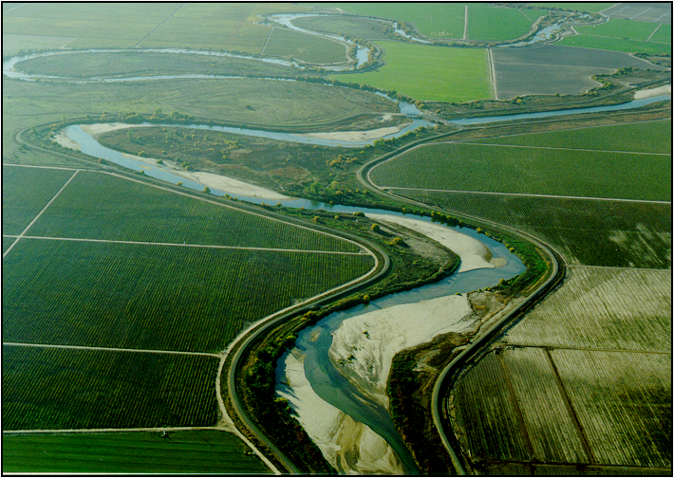
Vision Statement
The Federal and State governments share a vision for an integrated flood management system in the Central Valley to provide for safe, healthy and thriving communities while protecting and restoring the environment. The problem is so overwhelming that achievement of this shared vision can only be through pursuit of mutual priorities. The State’s flood risk management priorities of public safety, environmental stewardship and economic stability match the Federal administration’s priorities of protecting the American people, restoring and protecting the environment and improving the nation’s economy.

Slide 8
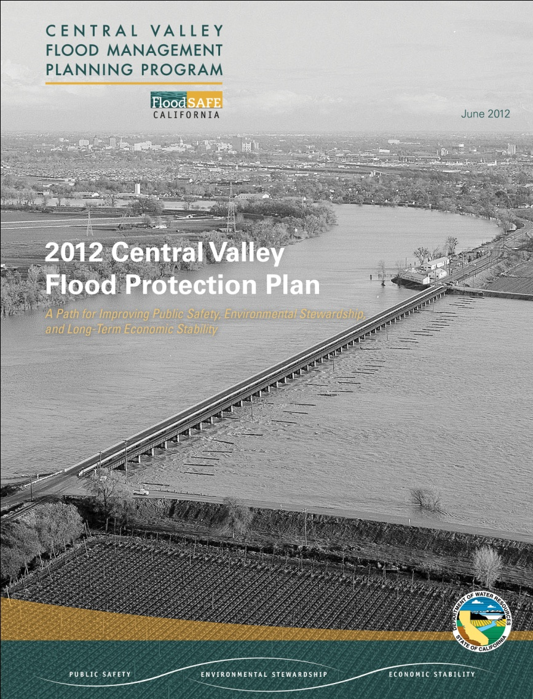
Ongoing Efforts
Leveraged existing information and models from State and USACE projects, including, but not limited to:
Central Valley Flood Protection Plan
Basin-wide feasibility studies
Bay Delta Conservation Plan
Regional Plans
Sutter Basin Project
Yuba River General Reevaluation Project
Yuba River Ecosystem Restoration Study
West Sacramento General Reevaluation Study
American River Watershed Program: Common Features and Folsom Dam Joint Federal Project
American River Common Features General Reevaluation Study
Sacramento River Bank Protection Project
Cache Creek Feasibility Study
Delta Islands and Levees Feasibility Study
Sacramento-San Joaquin Comprehensive Study

Slide 9
Recent Activities
Received funding to complete study June 2015
Completed draft determination of federal interest
Held two-day stakeholder workshop, 24-25 August 2015
Completed first draft watershed plan

Slide 10
Current Activities
  Completing sponsor and District Quality Control reviews
  Will send to South Pacific Division and to public for review this month

Slide 11
Planning Goals
Flood Risk Management
Reduce the risk to public safety from flooding in the Sacramento River Basin;
Reduce the risk of damages to residential, agricultural and commercial/industrial areas, and roads and other critical infrastructure due to flooding;
Ecosystem Restoration
Restore aquatic habitat for the Sacramento River ecosystem;
Restore natural stream processes in the Sacramento River; and
Water Supply/Conservation
Improve water supply reliability and availability

Slide 12
Array of Flood Risk Management
Management Measures
1. Widen bypasses Create new bypasses Modify weirs 4. Optimize operation of weirs 5. Automate weir operations Remove/modify obstructions Raise/strengthen existing levees New levees Setback levees Coordinated emergency response plans | Flood recovery plan Floodplain management plan 13. Create/enlarge floodplain storage Purchase flowage easements Re-operate/optimize reservoirs Raise/upgrade existing dams Forecast-based reservoir operations Re-allocate storage in reservoirs 19. Construct new dams

Slide 13
Array of Ecosystem Restoration
Management Measures
1. Increase shaded riverine aquatic habitat 2. Increase riverine aquatic habitat Increase riparian habitat Increase perennial marsh habitat Impoundments for wetlands Restore natural bank habitat Re-create channel meanders Remove barriers to channel migration Lay-back banks to connect with floodplain Terrace floodplains | 11. Re-contour floodway 12. Remove barriers to fish passage 13. Screen pump diversions 14. Extend floodplains/expand floodway 15. Set back levees 16. Notch weirs 17. Remove non-native species 18. Reservoir re-operation 19. Low flow channel in bypasses

Slide 14
Array of Water Supply
Management Measures
1. New dams that include water supply purpose 2. Re-operate existing dams to conserve more water 3. Enhance/increase groundwater percolation 4. Re-allocate storage in reservoirs 5. Improve existing water conveyance system

Slide 15
Watershed divided into 50 Opportunity Areas

Slide 16
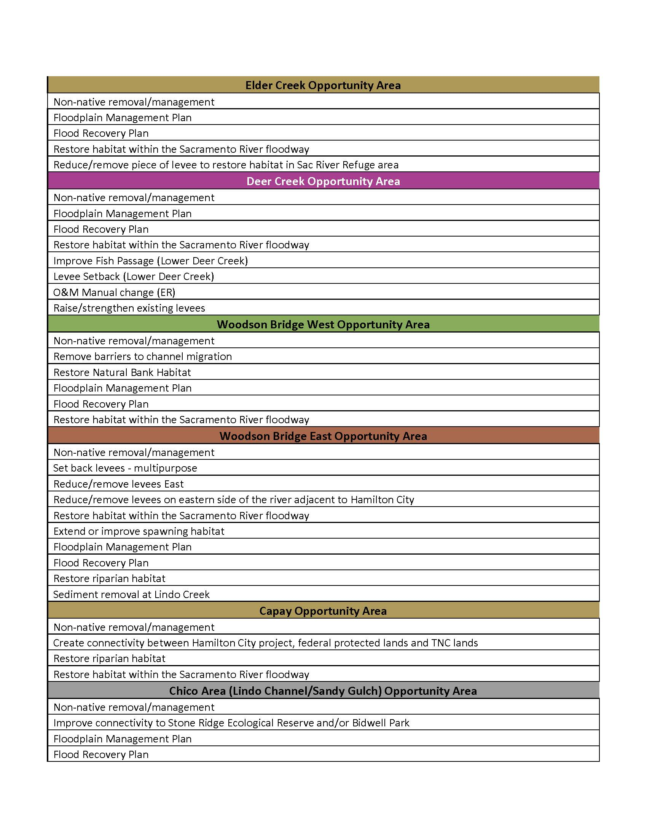
Array of Measures Applied as Appropriate to each Opportunity Area
Sample from CVIFMS features table

Slide 17
Qualitative Screening
Flood Risk Management Benefits
How well the feature could reduce risks to life safety from flooding
How well the feature could reduce the consequences associated with flood risk (with an emphasis on improving system resiliency and increasing the integrity of the flood system)
How well the feature could reduce risks to critical infrastructure from flooding
How well the feature could encourage wise use of the floodplain
Water Supply Benefits
How well the feature could increase the availability and reliability of water supply (groundwater and surface water)
Ecosystem Restoration Benefits
How well the feature could increase the area, quality, connectivity and diversity of significant native aquatic and related habitats
How well the feature could reduce barriers to fish passage
How well the feature could increase natural dynamic hydrologic and geomorphic processes
Which types of species the feature could benefit: 1) aquatic, 2) avian, 3) terrestrial or 4) all types (zero = no benefit; low = one type could benefit; medium = two types could benefit; high = all types could benefit)

Slide 18
Qualitative Screening Continued
FRM, ER and WS Costs
  The order of magnitude of costs for the feature
  The order of magnitude of mitigation that could be required for the feature
Features that were infeasible, non-policy compliant or that scored zero or less were screened out

Slide 19
Conceptual Alternatives
The remaining features were combined into seven conceptual alternatives as follows:
(0) No Action Alternative
(1) Non-Structural Flood Risk Management (FRM) Alternative
(2) Ecosystem Restoration (ER) Alternative
(3) Flood Risk Management Alternative
(4) Ecosystem Restoration and Flood Risk Management Alternative
(4a) Locally developed plan - Central Valley Flood Protection Plan and the draft Conservation Strategy
(5) FRM and Water Supply (WS) Alternative
(6) FRM, ER and WS Alternative
Notes:
(1) No Action Alternative
(2) Non- Structural Alternative – This includes flood risk management plans and flood recovery plans that include recovery of the ecosystem after flood events.
(3) Ecosystem Restoration (ER) Alternative – This includes the remaining ecosystem restoration features that were not screened out.
(4) Flood Risk Management (FRM) Alternative – This includes the remaining flood risk management features that were not screened out.
(5) Ecosystem Restoration (ER) and Flood Risk Management (FRM) Alternative – This is a combination of Alternatives (2) and (3).
(4a) Central Valley Flood Protection Plan (CVFPP) and the draft Conservation Strategy (CS) – This is a locally developed plan (LDP) submitted by the sponsors, the Central Valley Flood Protection Board (CVFPB) and the State of California Department of Water Resources (DWR). It is a combination of the flood risk management and ecosystem restoration features included in the 2012 CVFPP and the draft Conservation Strategy.
(5) FRM and Water Supply (WS) Alternative – This is a combination of alternative (3) and the remaining water supply features that were not screened out.
FRM, ER and WS Alternative – This is a combination of alternative (4) and the remaining water supply features that were not screened out.

Slide 20
Early “Off-shoot” Study
Sacramento River GRR – recently initiated study to revision the Sacramento River flood control system for flood risk management and ecosystem restoration
Notes:
Off-shoot = not comp study authority; under other existing authority

Slide 21
Draft Proposed “Spin-off” Studies
Near-term recommended “spin-off” studies include:
Climate Change Assessment under USACE Floodplain Management Services
  USACE, State, IWR, potentially other Districts in region and climate change experts
  Develop standard approach for assessing impact of inland climate change on decision criteria in future studies in this region
San Joaquin River Watershed Study (CVIFMS Part II) under General Investigations
  Originally included in this study, but during a re-scoping, San Joaquin River Watershed was recommended to be assessed in a second phase
  To address remaining portion of Central Valley, consistent with CVFPP and draft Conservation Strategy
Notes:
Spin-off = continuation under existing comp study authority

Slide 22
Draft Proposed “Spin-offs” Cont’d
Central Valley Reservoir Reoperation Study under General/Special Investigations –
  Operate system in a coordinated manner to optimize benefits
  Comprehensive investigation of reservoirs within both Sacramento and San Joaquin River Basins (USACE, State, USBR) to optimize operations for FRM, ER and WS across system of reservoirs, incorporating weather forecasts and climate change analysis.
  Logical and necessary next step to DWR’s Phase I and II reoperation studies (http://www.water.ca.gov/system_reop/)
  System reoperation has potential to produce benefits with little to no construction costs

Slide 23
Draft Proposed “Spin-offs” Cont’d
Middle and Upper Sacramento River Basin Comprehensive Study under General Investigations
  Multi-purpose ER, FRM and water supply study
  Study will consider sites located within middle and upper Sacramento River Watershed
  Study would complement Middle and Upper Sacramento Regional Plan and provide an opportunity to partner with both State and regional group
  Study area would include Sacramento and Feather Rivers and their tributaries
    Lower Sacramento River-Delta North area is not included in this recommendation

Slide 24
Draft Proposed “Spin-offs” and “Off-shoots”
Mid- to Long-Term “Spin-off” and “Off-shoot” Studies Include:
Non-Structural Floodplain Management Services
  Small-scale, non-structural projects that can provide floodplain mapping, floodplain management plans, emergency plans and flood recovery plans
  Could provide significant benefits to effected areas for low cost and effort
  May be critical for small communities, agricultural areas and Tribal communities
Upper American River and Tributaries
  Multi-purpose FRM, WS and ER study along American River and its tributaries (above Folsom Dam and Reservoir).
Ecosystem Restoration Studies under Continuing Authorities Program/General Investigations/Tribal Partnership Program
  Restore ecosystem in more localized areas, including on Tribal lands
  Areas such as Clear Lake/Upper Cache Creek, Elder Creek, Deer Creek and Stoney Creek among others

Slide 25
Draft Proposed “Off-shoots” Cont’d
Inter-Agency Support
  Support to sister federal agencies to assist with water resource projects for which USACE has an expertise
Planning Assistance to States
  USACE can provide states, local governments, other non-Federal entities and eligible Tribes assistance in preparation of comprehensive plans for development, utilization and conservation of water and related land resources.
  Studies could include: water supply/demand, water conservation, water quality, ecosystem restoration and dam safety/failure.

Slide 26
Other Considerations
Strategic Watershed Governance
Regional Permitting
O&M Challenges
Timing of State and Local Actions (Basin-Wide Feasibility Studies / Regional Flood Management Plans / Near-term Implementation)
Notes:
These are policy issues to be resolved outside the direct planning process: improvement to strategic watershed governance and regional permitting.
There is a need for a governance structure that includes all State and Federal partners who are decision makers and/or major resource providers (IRWM). There should be a Federal presence in watershed governance (possibly USACE, NMFS, others).
Need to ensure some steps are undertaken to look at regional permitting to streamline and expedite the (Federal) permitting process.
Could be included in the “General Recommendations” section of the Watershed Management Plan.
We are continuing to pursue policy discussions in these two areas with Jerry Fuentes leading governance and Michael Jewel (Chief of Regulatory) leading regional permitting.

Slide 27
Questions/Discussion

Slide 28
Contacts
USACE: Public Affairs Office
CVIFMS@usace.army.mil
Glen Reed, Project Manager, (916) 557-5332
anthony.g.reed@usace.army.mil
Rhiannon Kucharski, Lead Planner, (916) 557-7258
rhiannon.l.kucharski@usace.army.mil
DWR: Christopher Williams, Project Manager
(916) 574-2375
christopher.williams@water.ca.gov
CVFPB: Nancy Moricz, Senior Engineer, CVFPB,
(916) 574-2381
nancy.moricz@water.ca.gov

